Slide 1

MENTAL HEALTH PROMOTION AND INTERVENTION IN OCCUPATIONAL SETTINGS

Slide 2

CONSORTIUM
17 partners across
13 European countries
& Australia

Slide 3


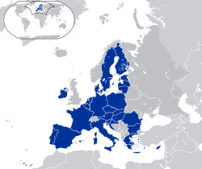
What is MENTUPP?
We seek to improve mental health in Small and Medium Enterprises (SMEs) in the construction, health and ICT sectors.
Project financed by the EU
Highest ranked of over 100 proposals
13 European countries and Australia participating

Slide 4
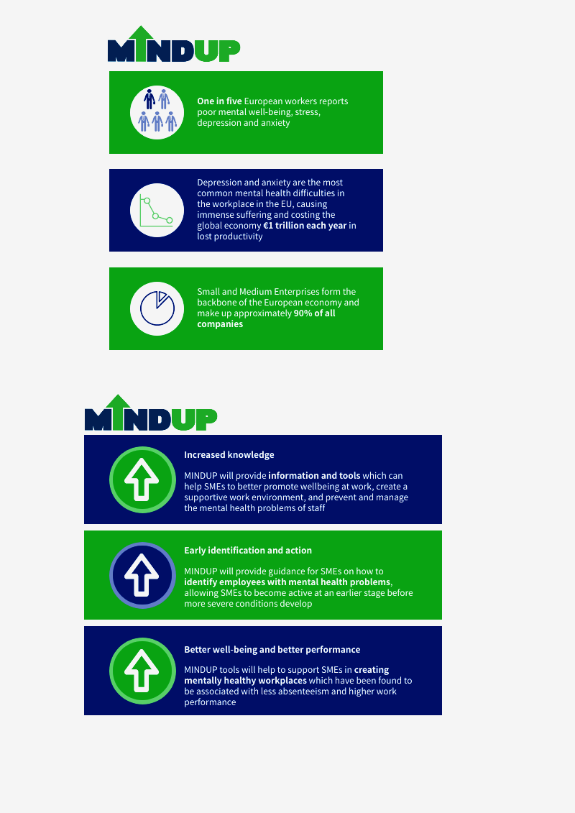
Why is the MENTUPP project important?

Slide 5
Albania
Country specific fact #1 e.g. 4.8% of the population in Albania are diagnosed with depressive disorders, WHO Report 2017
Country specific fact #2 e.g. Anxiety disorders involved 3.56% of the population in Albania, “Lancet Commision on Global Mental Health” survey, 2019
Country specific fact #3 e.g. stigma, etc For Research Officers: Please add in here any relevant workplace mental health statistics for your country

Slide 6
Workplace
Mental Health
A healthy workplace can: Enhance the productivty of employees Boost performance and engagement of employees Increase job satisfaction
How to create a healthy workplace: Talk about mental health Enhance awareness of mental health Direct employees that need help to support
For Research Officers: Please add in here any relevant workplace mental health statistics for your country

Slide 7
ICT Sector
Employees in some sectors are more likely to have high levels of occupational stress and burnout, and increased risk to anxiety and depression Research identifies – healthcare, ICT, construction
Sector specific fact #1 (e.g. Constant pressure to deliver services efficiently and promptly in a fast-paced working environment)
Sector specific fact #2 (e.g. Higher use of ICT by nature, which is often linked to stress and negative impact on mental health)

Slide 8
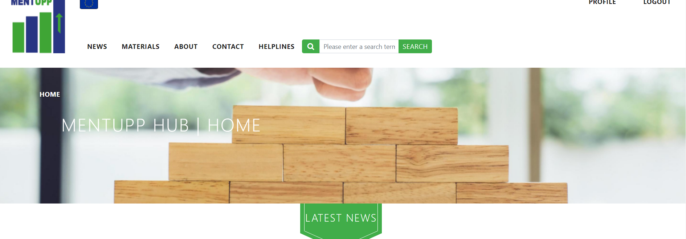
What does MENTUPP offer?
Free access to the MENTUPP Hub, an online training programme to improve the wellbeing of employees at work.

Slide 9
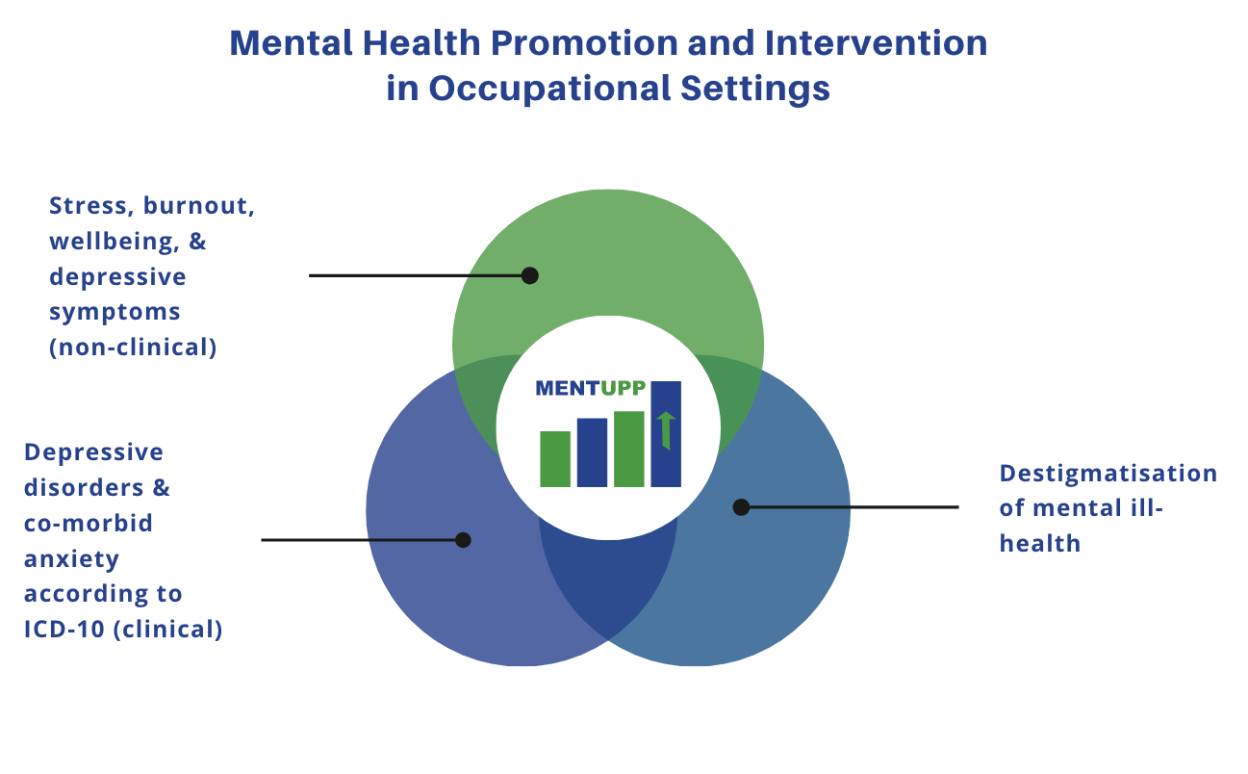
MENTUPP targets mental health and wellbeing, as well as stigma related to mental health

Slide 10


The strongest impact of MENTUPP is before someone encounters a stressful situation (or before entering counselling).

Slide 11

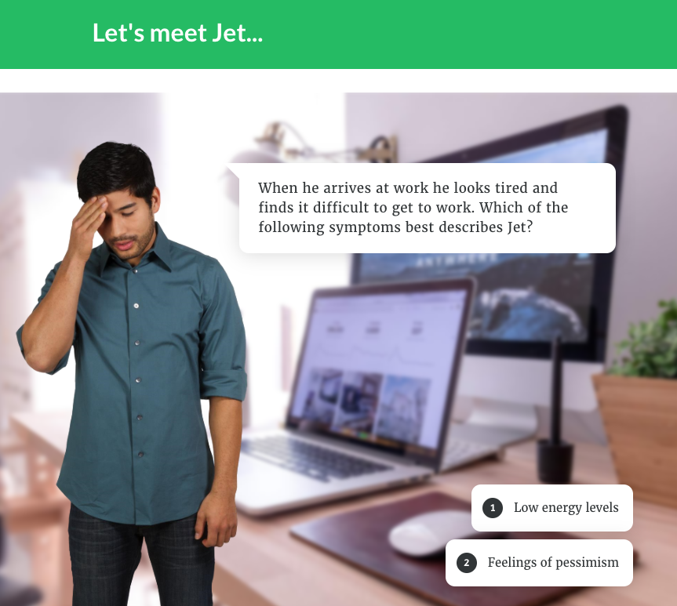
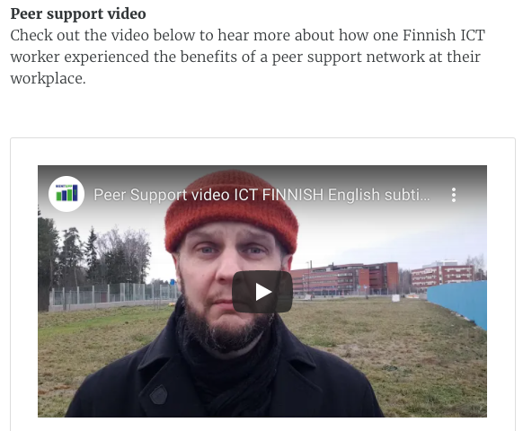
Tailored material -
ICT Sector
Graphics
Characters
Workplace

Slide 12
Building capacity at all levels
Employee
Group (Peers)
Whole Organisation
Leader
Notes:
From Zalsman: In the quest for effective suicide prevention initiatives, no single strategy clearly stands above the others. Combinations of evidence-based strategies at the individual level and the population level should be assessed with robust research designs.
From Nielsen: According to the IGLO model, sources of mental health and well-being at work exist at all levels of the organisation. Therefore, for interventions to reach optimal degrees of effectiveness, they should tackle all such levels or, where this is not feasible or justified, at least several of them.
Primary interventions are aimed at preventing employees from developing health issues. As such, primary interventions focus on the elimination of stressors in the environment. Secondary interventions tend to focus on employees who may be at risk for developing mental health and well-being issues or employees in vulnerable subgroups. The objective for secondary interventions is thus to support individuals in dealing with stressors, thus boosting resilience

Slide 13


MENTUPP Hub
In your local language
Completely anonymous

Slide 14
Why participate in MENTUPP?
Free access to new resources created by international experts
Possibility of reducing absenteeism costs
Opportunity to improve the productivity of the business
Company reputation - valuing employees and supporting a healthy workplace
Chance to build a best practice model
1
2
3
4
5

Slide 15
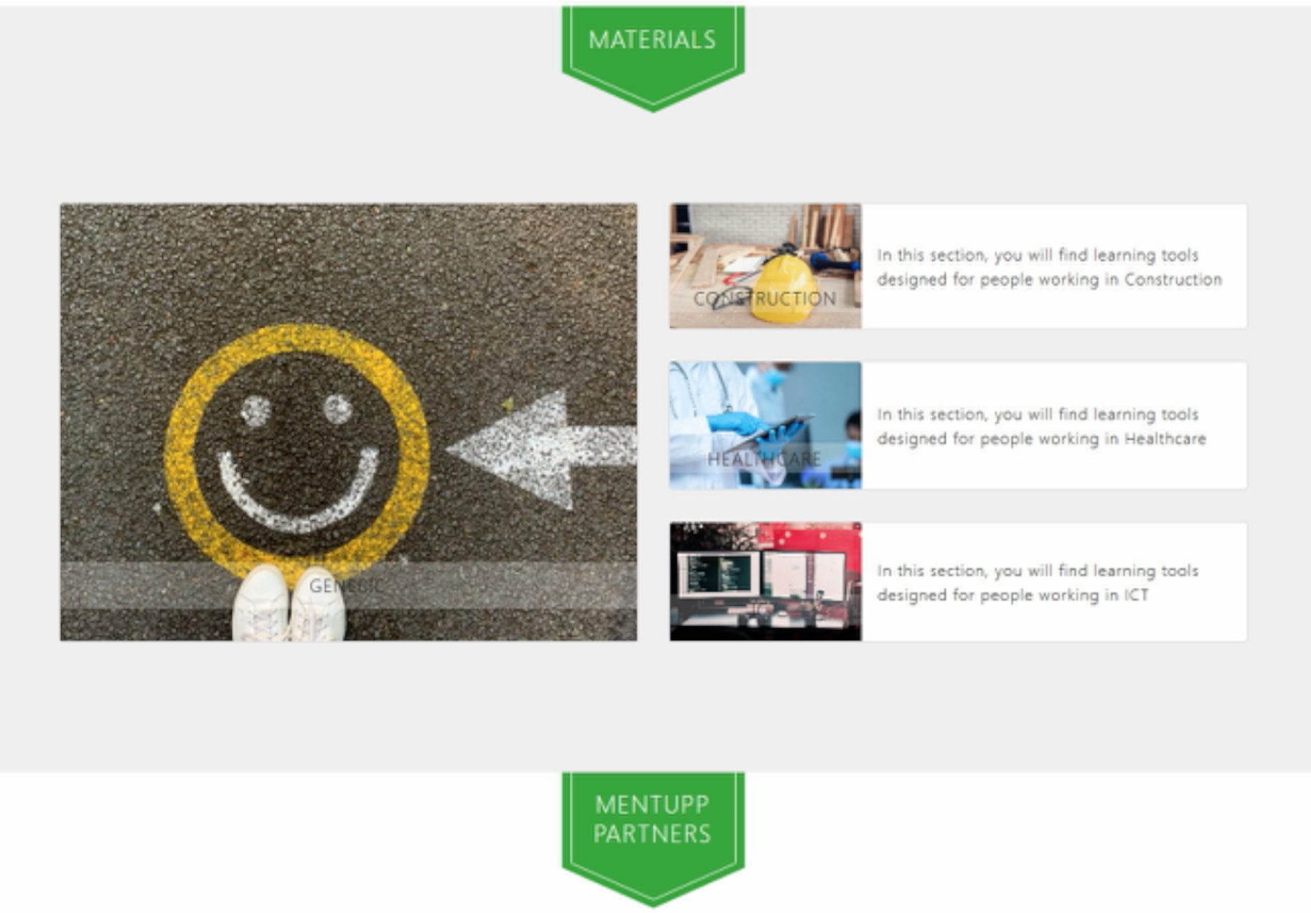
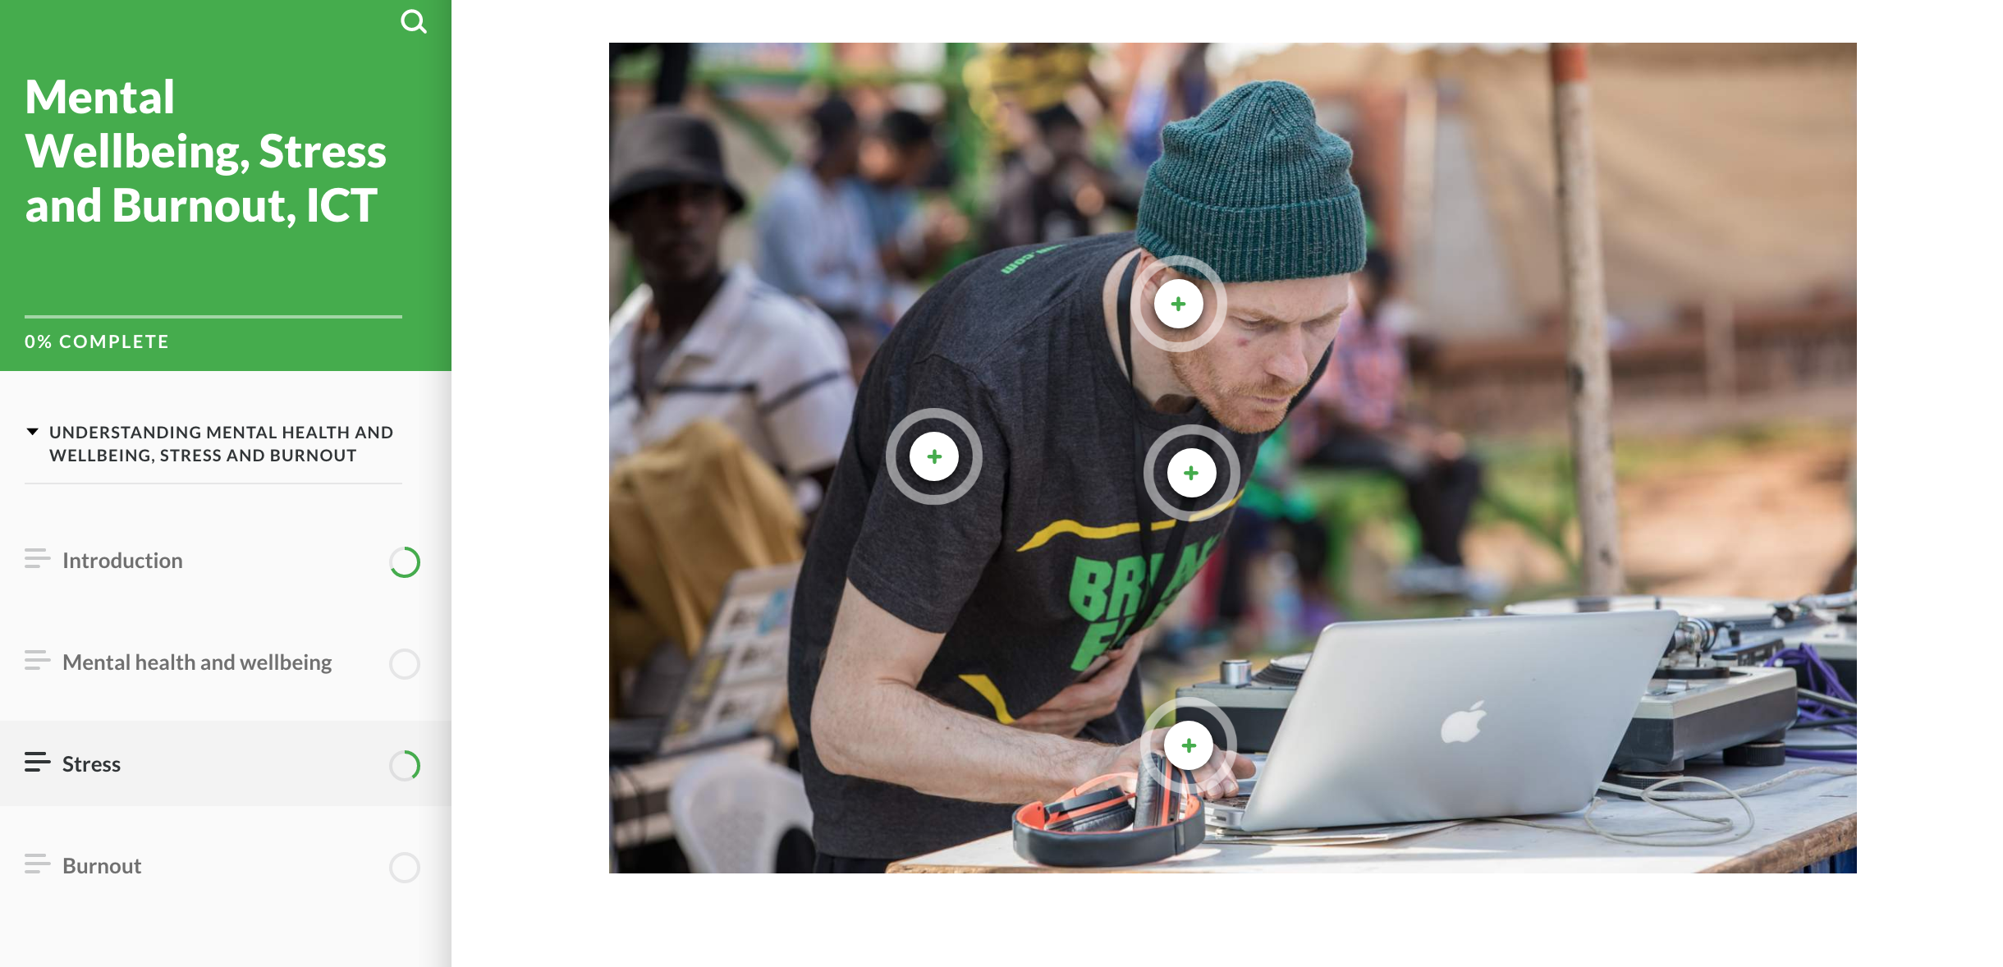
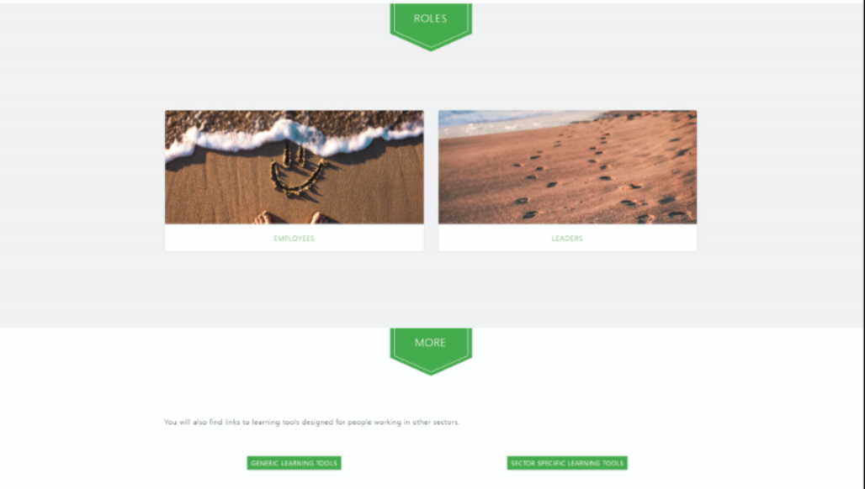
MENTUPP: What is it?
The MENTUPP Project will test how and if the MENTUPP Hub helps SMEs in Europe and Australia to build mentally healthy workplaces.
The project starts in June 2022 and will be conducted over 13 months
54 SMEs across 9 countries will take part
Half the SMEs will be in the ‘intervention group’ and access the Hub immediately
Half the SMES will be in the ‘waitlist group’ and not access the Hub until after the project ends
This way we can compare the two groups and see the impact of the Hub

Slide 16
MENTUPP Project Timeline
June 2022
Project starts
Fill in surveys
MENTUPP Hub Use for Intervention Group
Feb 2023
9-month follow-up surveys
July 2023
13-month follow-up surveys
June 2022 – May 2023
June 2022
July 2023
MENTUPP Hub Access for Intervention Group and Waitlist Group

Slide 17
Keen to be involved in MENTUPP?
Organisational commitment
Promote MENTUPP via internal communication channels
Allow staff work time to use the MENTUPP HUB
Start a conversation about mental health in your workplace

Slide 18

We make mental health a priority
in our workplace
Would you like to join us?

Slide 19

Thank you
Contact us at: mentupp@eaad.net

